Slide 1
Object Oriented Design and C
David Sackstein
All rights reserved

Slide 2
Agenda
C and C++ interoperability
A gradual migration to C++
Calling C code from C++
Calling C++ code from C
Defining an object in C
Interfaces in C

Slide 3
Interop
C++ is a superset of C
The two languages can be used in the same project (executable, shared library).
This makes it easy to migrate a C project to C++ in small steps.

Slide 4
Calling C code from C++
In C++ function names are not what they seem.
They are mangled to include information about the arguments and their types.
You can prevent the compiler from mangling names using extern “C” {}
To call the functions in c.h from c++ you need to wrap the inclusion of c.h with extern “C” {}

Slide 5
Calling C++ code from C
__cplusplus
For the same reason, you can only call a C++ method from C if it is not name-mangled (or you know it mangled name).
For C++ methods wrap the declaration in the header and the implementation in extern “C”
As extern “C” is invalid syntax in C, wrap its use with ifdef __cplusplus

Slide 6
Defining an object in C
In a header define a struct.
In a c file with the same name, define methods that accept a pointer to the struct as their first parameter (you can call it ‘this’).
Define a constructor and a destructor
In the header declare the methods you want public.
Do not declare the methods you want private
In the source file mark the methods you want private as static.
You can define an interface as a struct containing pointers to functions.

Slide 7
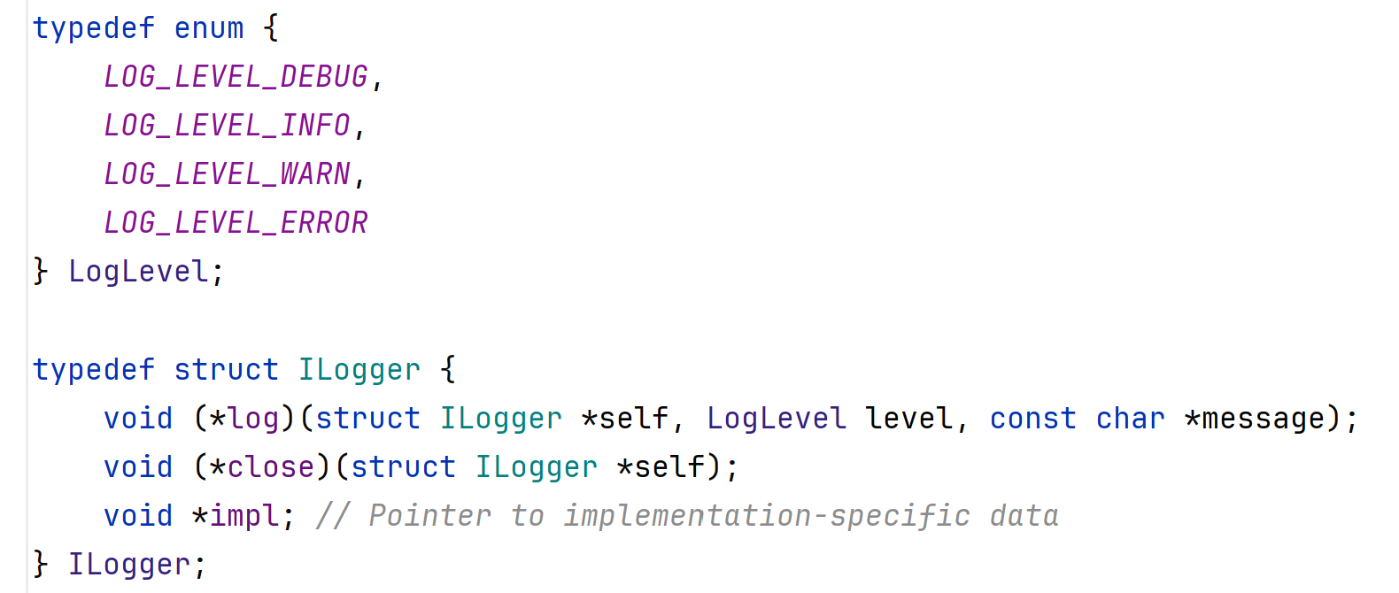
The ILogger interface

Slide 8
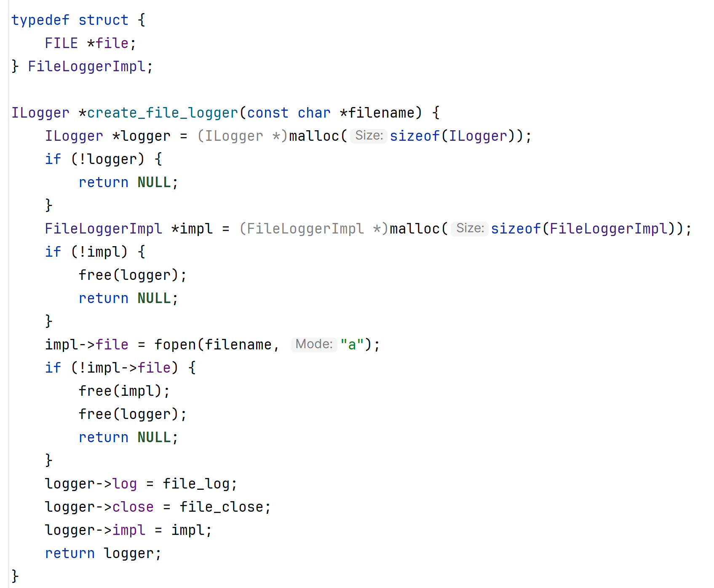
The FileLogger implementation

Slide 9
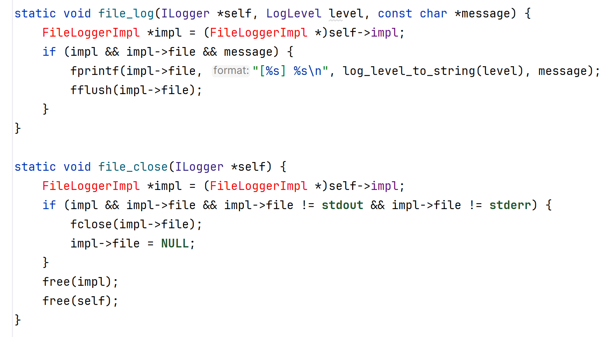
The FileLogger implementation

Slide 10
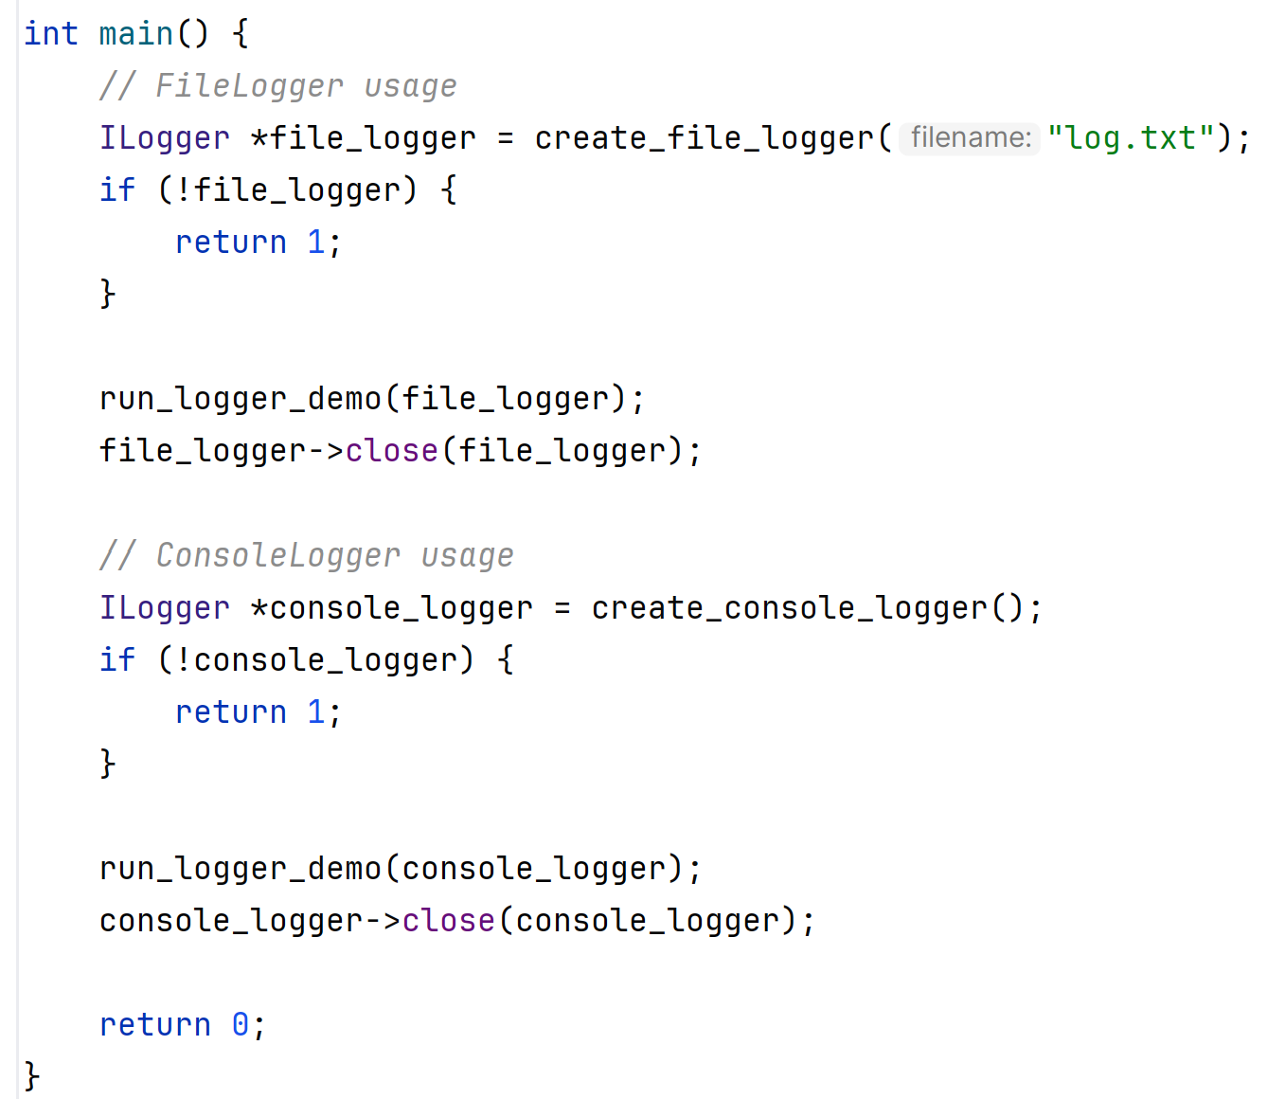
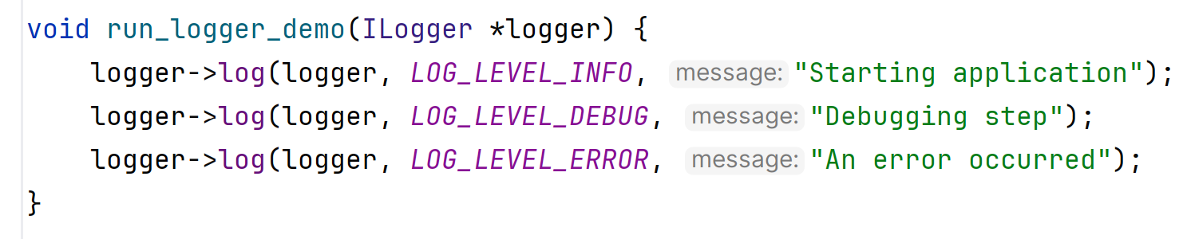
Use like in C++

Slide 11
Key Takeaways
The principles of OOD are useful in C too.
The problem is that you need to do a lot of work yourself, and also the compiler does not force you to write correctly.
But you should write constructors, destructors and use the static keyword to hide symbols
You can implement interfaces as structs of function pointers.
Due to interop of C and C++ you can migrate incrementally (you can use shared libraries to help here).

